Slide 1


Variables
&
Conditional Statements

Slide 2
Recap!
We should know how to…
Print things
Identify difference between integer and float
Perform basic math
Taking user input
Checking the type of anything
Identifying different string types

Slide 3
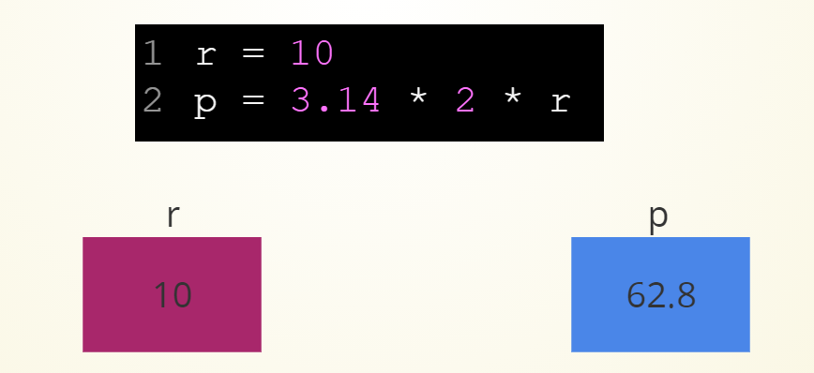
variables
A variable is a named memory location
Think of it as a box
Like a box, it can contain values
Can think of binding hotkeys in games?
You can edit/change/manipulate the contents inside it

Slide 4
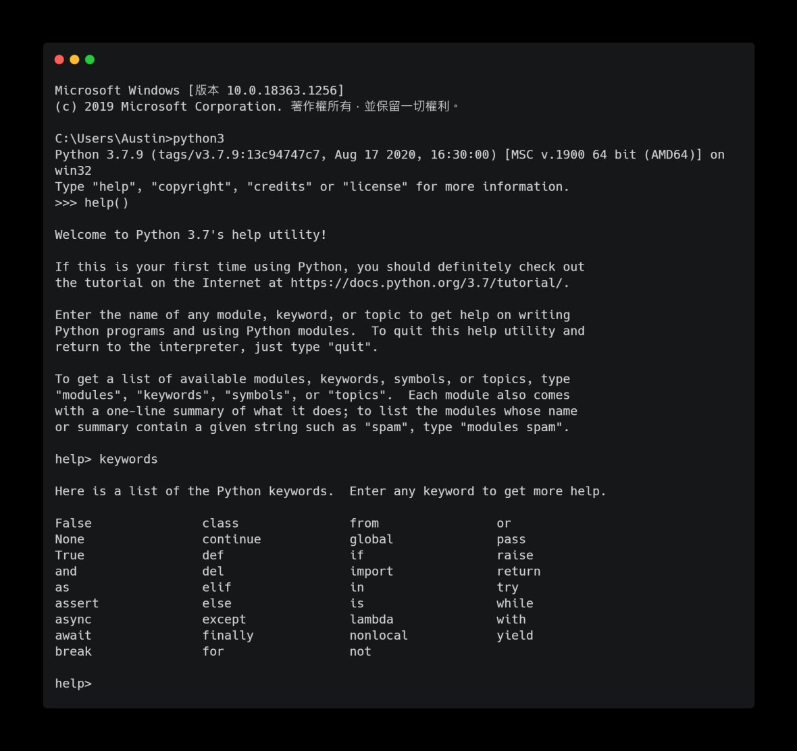
Rules for variables
Consists of letters, numbers, or _
Does not start with a number
Not a reserved keyword
Case sensitive

Slide 5
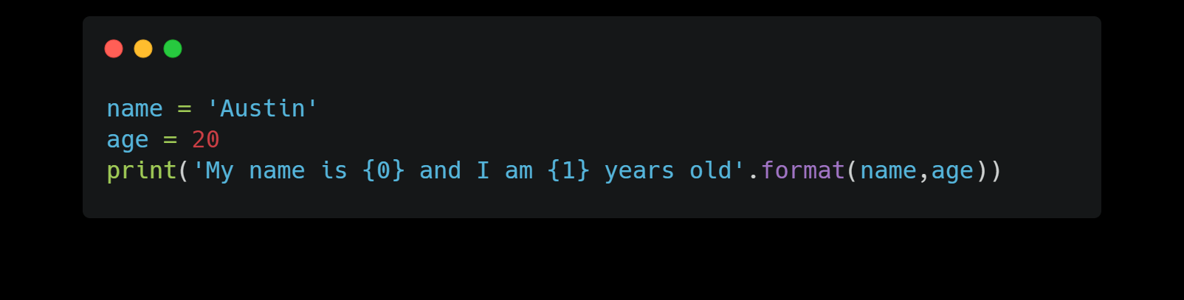
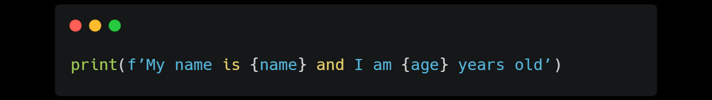
More about strings
(format)
Used to construct strings using placeholder values
Placeholder MUST be in {}
Start from 0

Slide 6
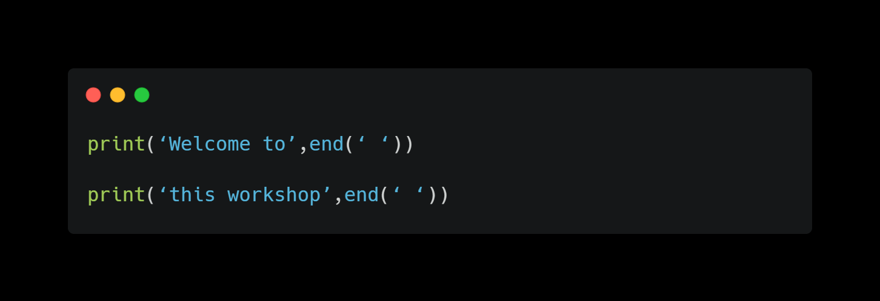
More about strings
(end parameter)
Default parameter for print() is a new line
Having the end parameter allows you to end a print statement with any string

Slide 7
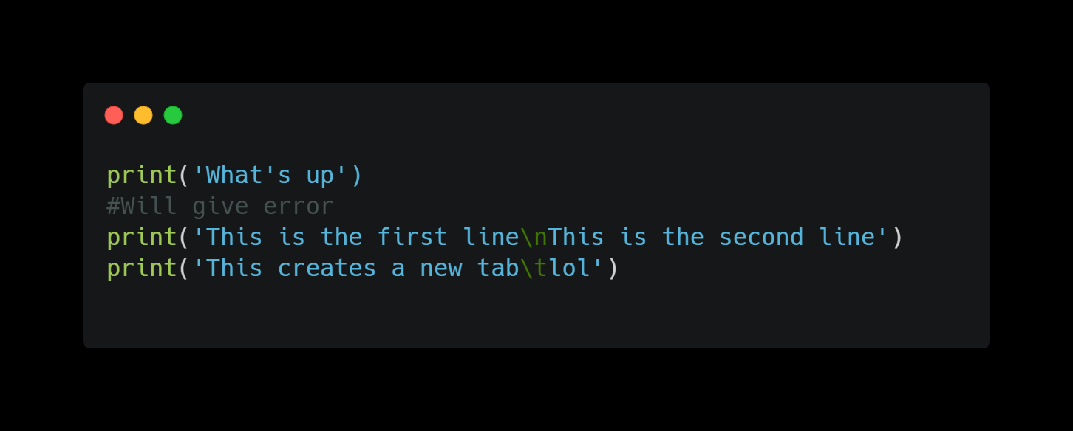
Escape sequences
Changing and formatting string that matches the syntax
String that contains a single quote
Create tabs and new line
Can use \ , \t, \n

Slide 8
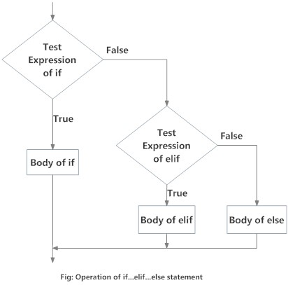
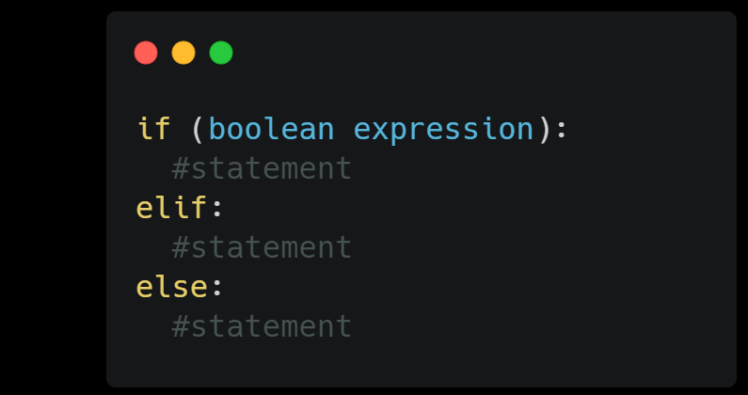
Conditional statements
(if else Statements)
Allows you to ask the computer to make decisions depending on different situations
Kind of like turtle! (Turn left/right if hitting a wall)
If/else, for , while
Can use pass as placeholders
Can be condensed to 1 line

Slide 9
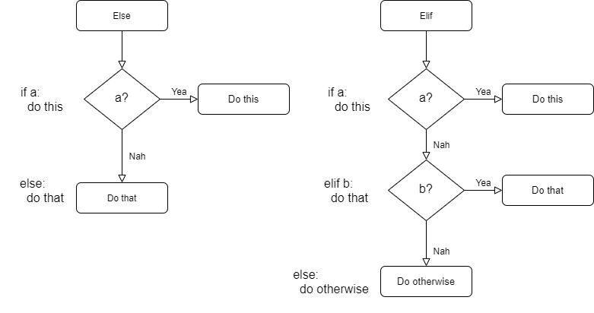
Else vs elif
Adds another branch for the condition

Slide 10
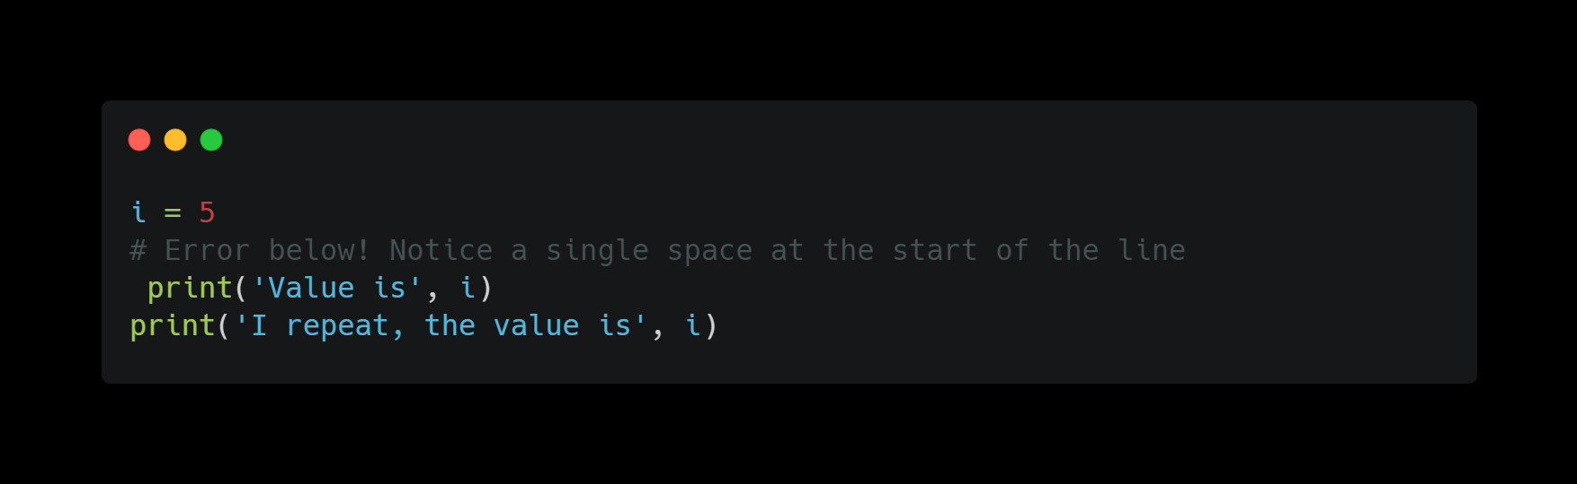
Whitespacing and
indentation
Very important in Python
Used to determine the grouping of statements
Statements that goes together MUST have the same indentation, like a block
IndentationError

Slide 11
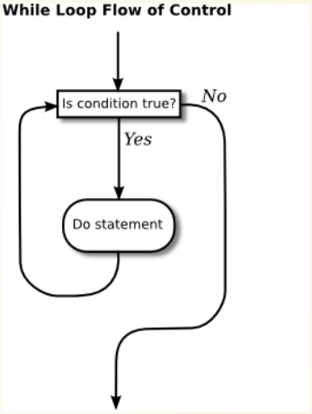
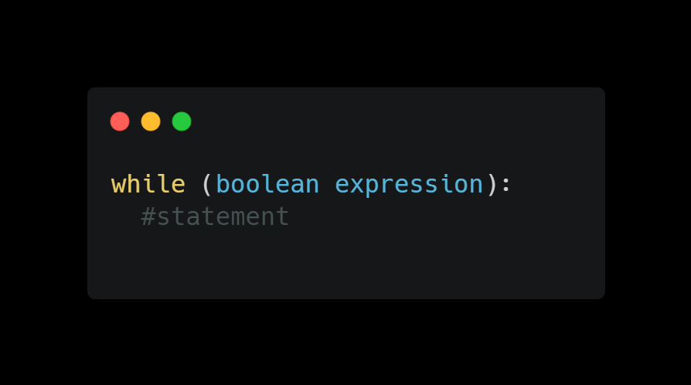
While statement
Allows you to repeatedly execute a block of statements as long as a condition is true
An example for a looping statement
Can include if else statements

Slide 12
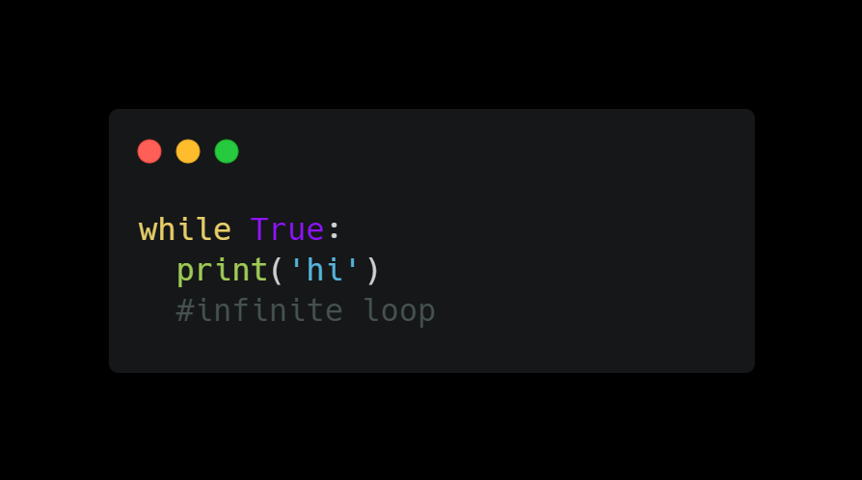
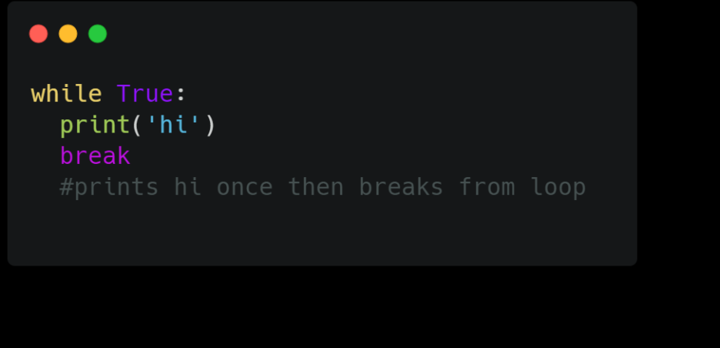
Things to note about
(infinite loop)
Happens when you don’t have an end condition in a for/ while loop
Add a counter
Add a break statement to force stop

Slide 13
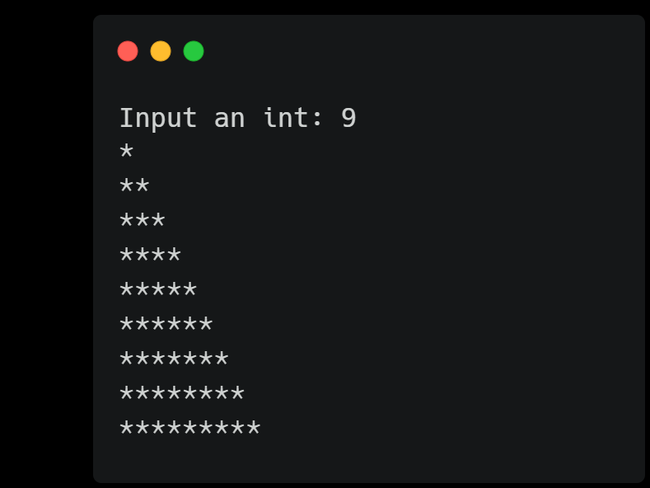
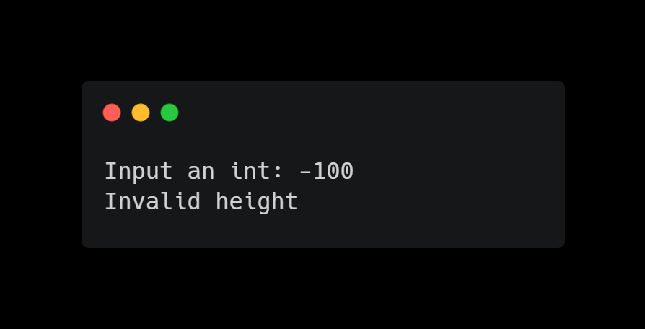
Challenge!!
Create a program to take input and print out * with the given height.Check if the value is less than 0, then print out “Invalid height”
Hint: create an input statement, create an if statement to check, and while loop to print *

Slide 14
Thanks!!
Email: ayyen@ucsc.edu

